Slide 1


Changes should be first-class objects in the modern data stack
Mihai Budiu – feldera.com
Minneapolis, Sept 11, 2025

Slide 2

Mihai Budiu - Short bio
Ph.D. from Carnegie Mellon University
Currently: feldera.com – chief scientist
Previous: Microsoft Research Silicon Valley, Barefoot Networks, VMware Research
Apache Calcite PMC member
https://mihaibudiu.github.io

Slide 3

Questions
What are changes?
How to represent changes?
How to use changes?

Slide 4

Answers
What are changes?
diffs
How to represent changes?
Z-sets
How to use changes?
Incremental computation

Slide 5

1. Changes

Slide 6


Slide 7


Slide 8
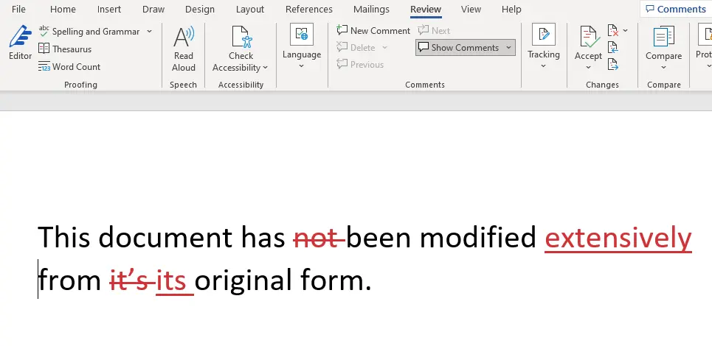

Slide 9
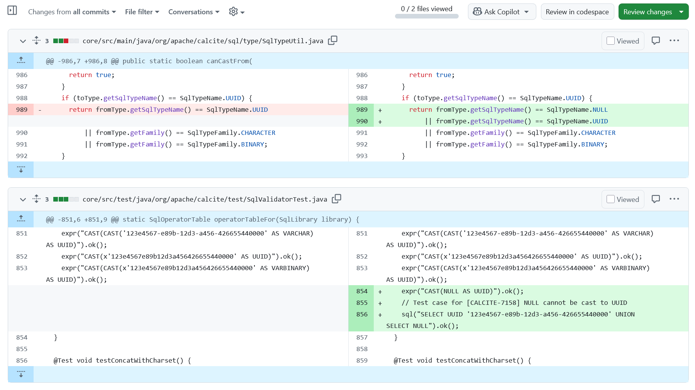

Slide 10
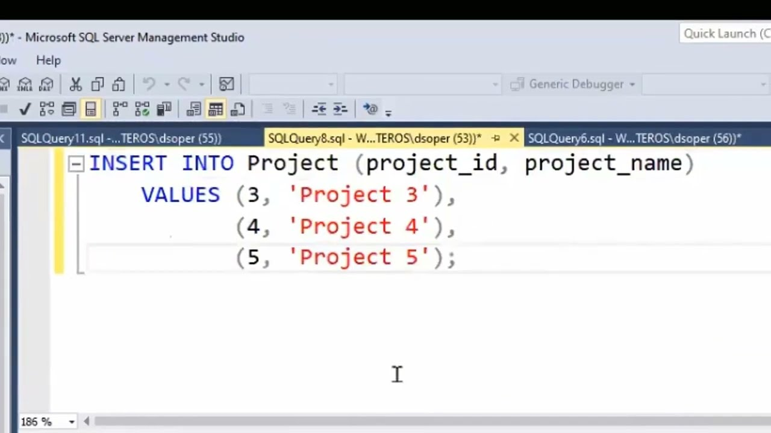

Slide 11
CREATE TABLE DEPOSITS( customer VARCHAR, amount DECIMAL );
INSERT INTO DEPOSITS VALUES('Mihai', 100.00);
INSERT INTO DEPOSITS VALUES('Mihai', -60.00);
Change in account value
May be negative!

Slide 12
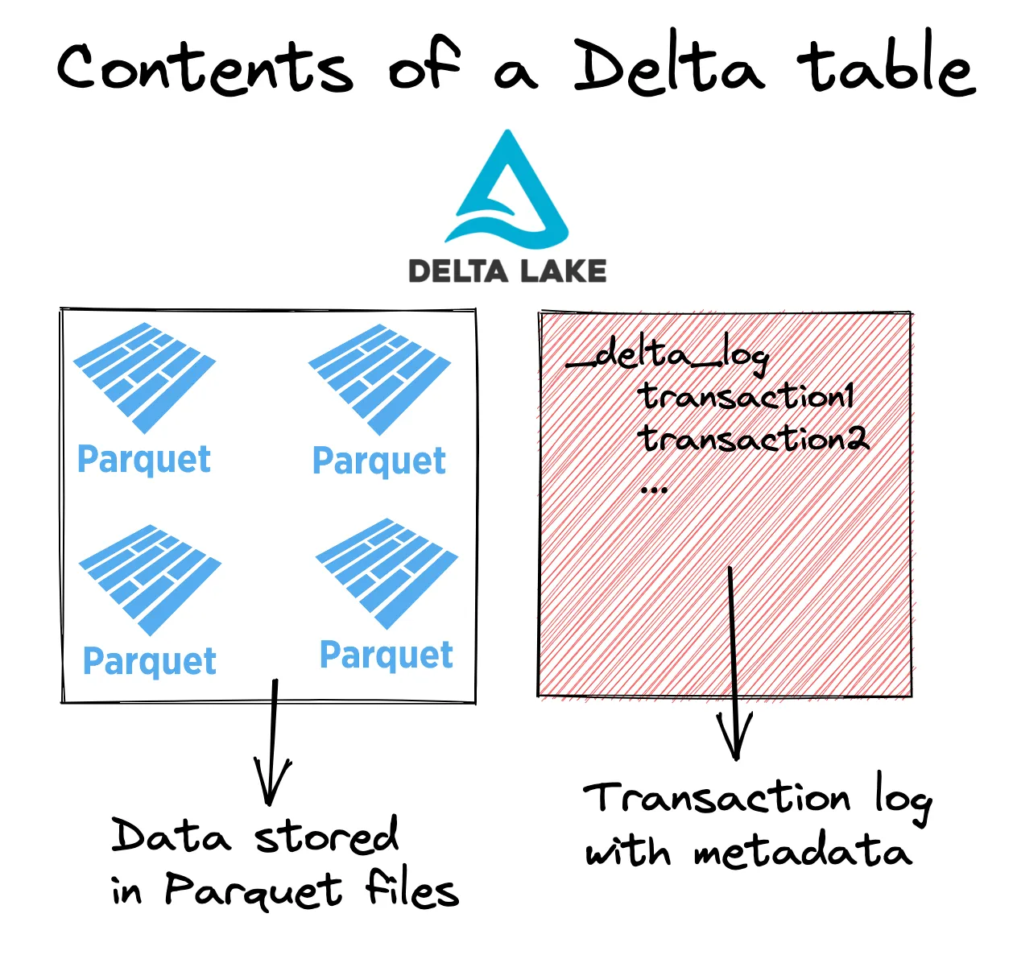
Data
Changes
https://delta.io/blog/2023-04-19-faster-aggregations-metadata/

Slide 13

This talk
Changes in database table data
We don't consider schema changes

Slide 14


Table changes
$$Δ$$
Table
Change
Table
Databases understand these
But struggle with these

Slide 15
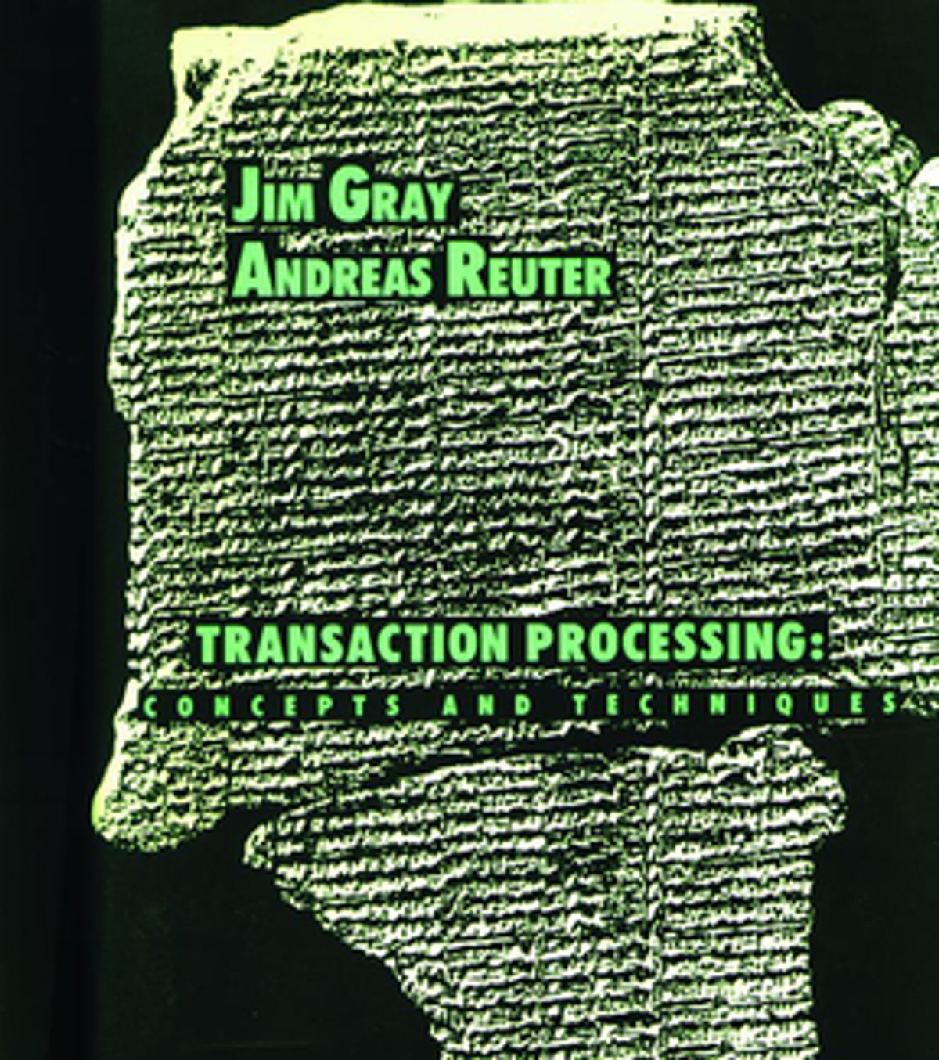
A database transaction
is a change that may span multiple tables

Slide 16
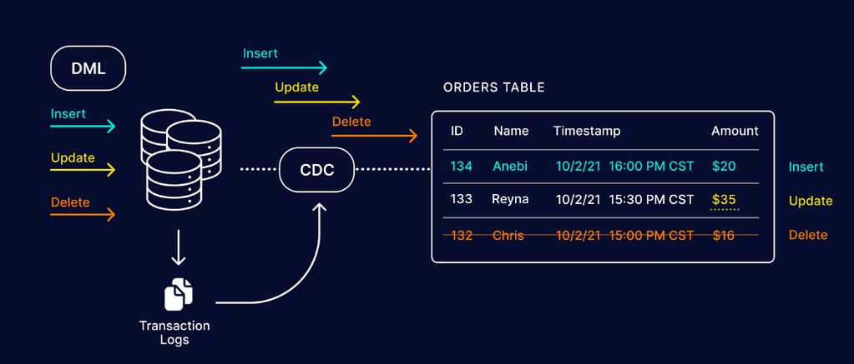
This box should not exist
It should be a service provided by the DB
These should use the same format

Slide 17

Changes should be first class-objects!

Slide 18
The end goal
data
processing
system
Changes
Changes

Slide 19

2. Z-sets: a data structure for representing changes

Slide 20
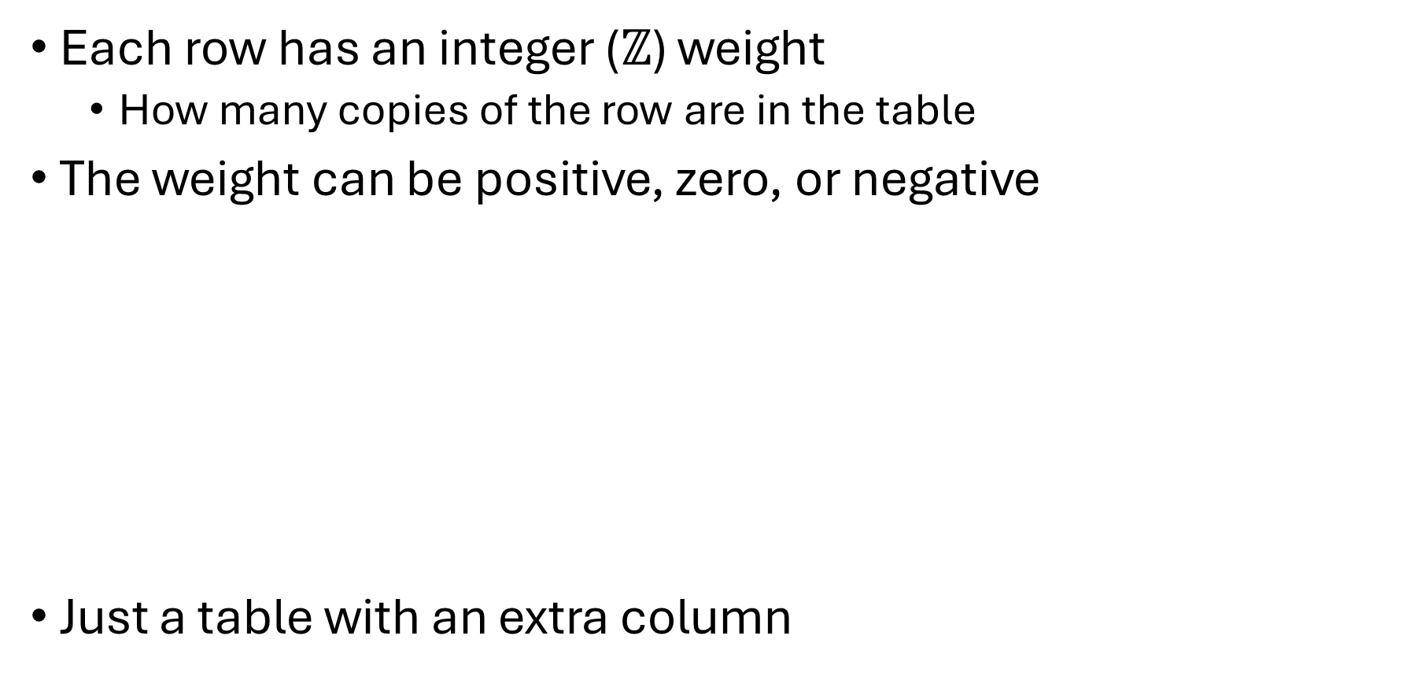
Z-sets = tables + weights
Each row has an integer ($ℤ$) weight
How many copies of the row are in the table
The weight can be positive, zero, or negative
Just a table with an extra column
Name | Age
Mike | 10
John | 12
Amy | 8
Chris | 10
Name | Age | Weight
Mike | 10 | 1
John | 12 | 3
Amy | 8 | -1
Chris | 10 | 2
rows

Slide 21
Z-set union (addition)
Name | Weight
Mike | 1
John | 3
Amy | -1
Chris | 2
Name | Weight
Mike | -1
Dan | 1
Chris | 1
Name | Weight
Dan | 1
John | 3
Amy | -1
Chris | 3
Mike | 0
+
=
Match rows, add weights
Rows with weight 0 can be removed

Slide 22

Z-sets are magic
Can represent both tables and changes to tables
Positive weights = rows added
Negative weights = rows removed

Slide 23
A standard table is a Z-set too!
Name | Age | Weight
Mike | 10 | +1
John | 12 | +1
Amy | 8 | +1
Chris | 10 | +1

Slide 24

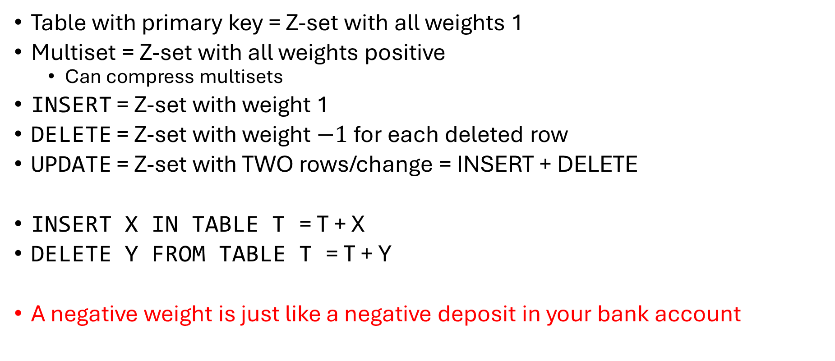
Z-sets are powerful
Table with primary key = Z-set with all weights 1
Multiset = Z-set with all weights positive
Can compress multisets
INSERT = Z-set with weight 1
DELETE = Z-set with weight $−1$for each deleted row
UPDATE = Z-set with TWO rows/change = INSERT + DELETE
INSERT X IN TABLE T = T + X
DELETE Y FROM TABLE T = T + Y
A negative weight is just like a negative deposit in your bank account

Slide 25

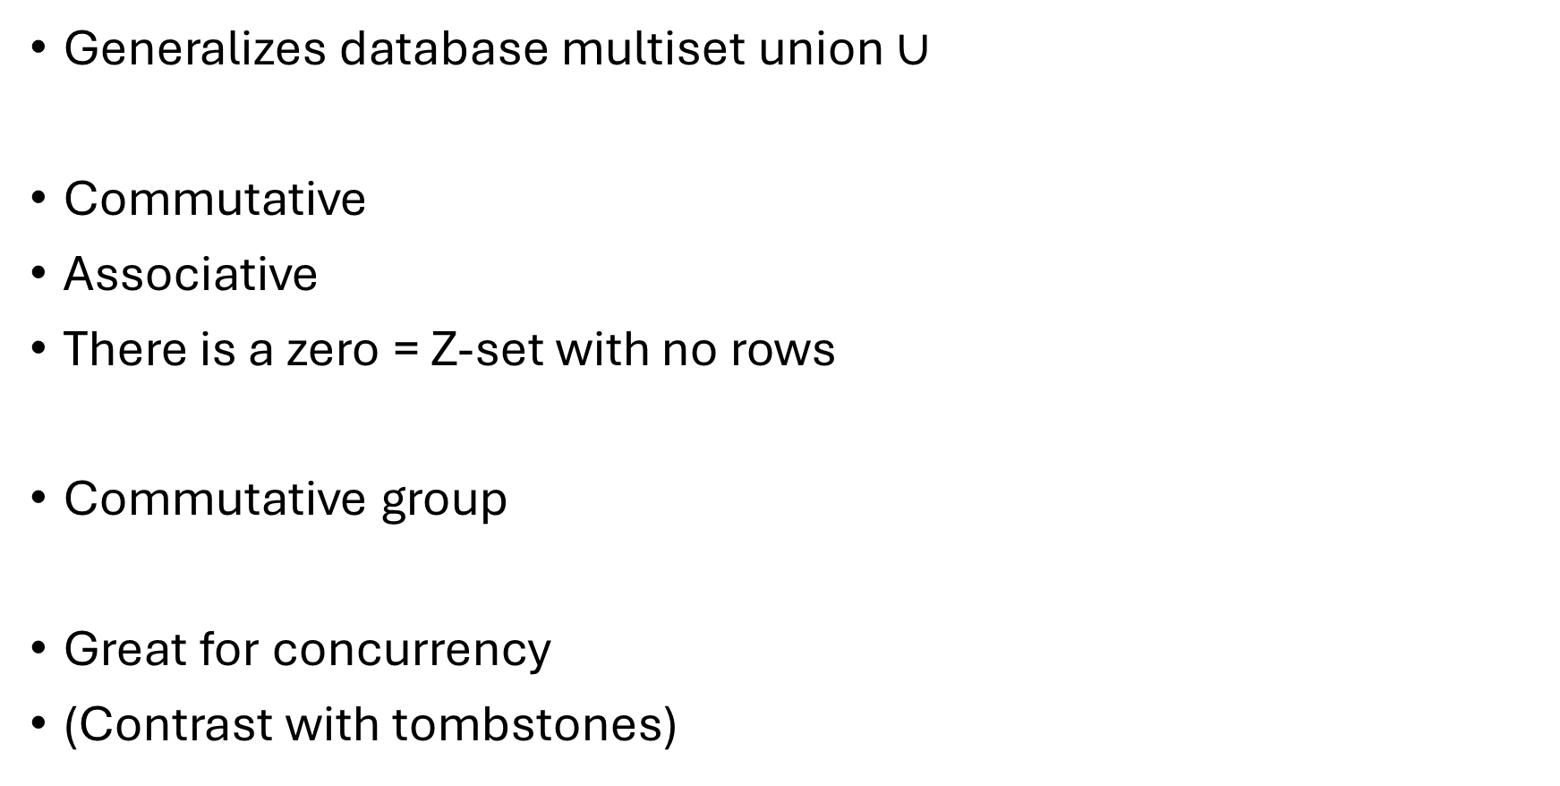
Addition is very nice
Generalizes database multiset union $∪$
Commutative
Associative
There is a zero = Z-set with no rows
Commutative group
Great for concurrency
(Contrast with tombstones)

Slide 26

3. Incremental computation

Slide 27


A database and a query
$$Q$$

Slide 28
Keep the result up-to-date
CREATE VIEW V AS …
V
V
V
V
V
$$Q$$
$$Q$$
$$Q$$
$$Q$$
$$Q$$
$Δ$DB
$$ΔDB$$
$$ΔDB$$
$$ΔDB$$
$$ΔDB$$
~100 rows
~1B rows
Time
transactions

Slide 29

Incremental computation
When a new deposit occurs
Update the funds for the corresponding person
Do not recompute funds for everyone

Slide 30
Incremental View Maintenance
1B / 100 = 10 million times faster!
V
V
V
V
V
$$ΔV$$
$$ΔV$$
$$ΔV$$
$$ΔV$$
$Δ$V
$$Q$$
$$Q^{Δ}$$
$$Q^{Δ}$$
$$Q^{Δ}$$
$$Q^{Δ}$$
$$Q^{Δ}$$
$$ΔDB$$
$$ΔDB$$
$$ΔDB$$
$$ΔDB$$
$$ΔDB$$
Time

Slide 31
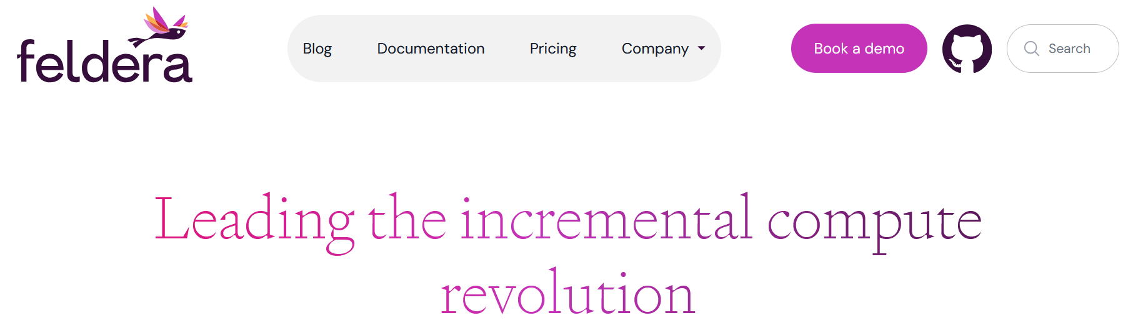
This can be done! For any query!
The gist: SQL query engines can compute directly on Z-sets
DBSP: Automatic Incremental View Maintenance for Rich Query Languages, VLDB 2023 best paper
Streaming Incremental View Maintenance with Apache Calcite Mihai Budiu, Community over Code, Hallifax, October 7, 2023

Slide 32
Z-sets could be everywhere!
V
V
Tables and views
Table and view changes
Change Data Capture streams
Database logs
INSERT and DELETE statements
Transactions
$$ΔV$$
$$Q$$
$$Q^{Δ}$$
$$ΔDB$$
Z-sets should be the standard data exchange format

Slide 33
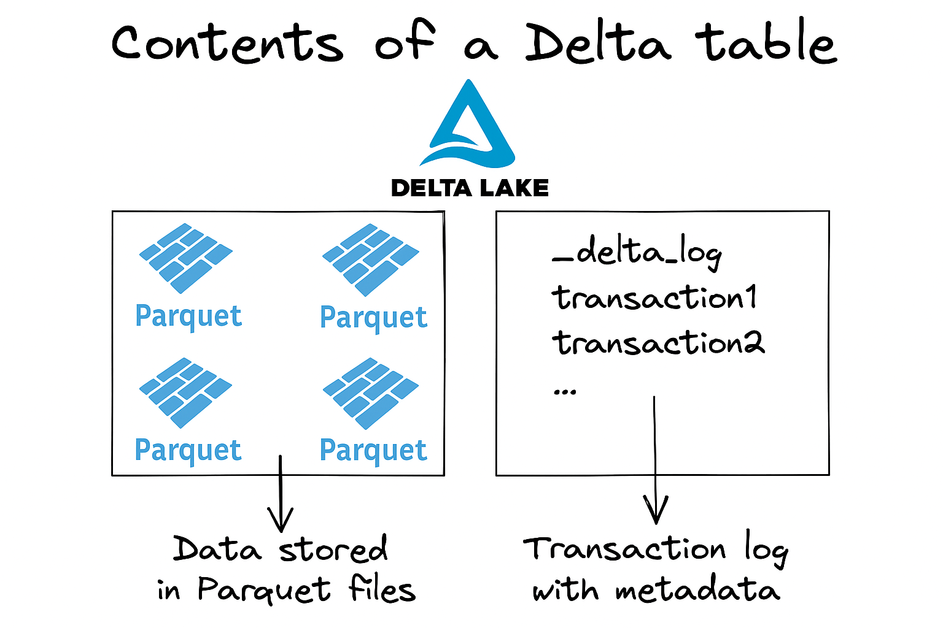

Data lakes should use Z-sets!
Z-sets
Z-sets
Today
Tomorrow

Slide 34



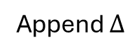
Uniform access to data and deltas
Existing data
Append $Δ$
Write path
Read path
Compaction

Slide 35

Unified streaming + database system
streaming + batch
query engine
DB updates
Z-sets
Q
Z-sets
relations
Z-sets
Q
Z-sets
subscribers
Streams
Views
Z-sets
storage
layer
tables

Slide 36
Composable data systems
data
Z-sets
Z-sets
data
Today:
Data
source
input
adapter
streaming
engine
output
adapter
Data
sink
Example:
SQL
CDC
Flink
log
Data lake
Z-sets
Z-sets
Z-sets
Z-sets
streaming engine
streaming engine
streaming engine
Tomorrow:

Slide 37

Summary
Z-sets: a simple table data format
Table with an extra weight column
Unifies change and data representation
Union is commutative, associative
Data systems should
Ingest changes from sources
Produce changes for subscribers
Incremental computation
Compute directly on changes
Can be orders of magnitude more efficient
Embrace changes!
My flight yesterday was
Coincidence?

Slide 38
Extra slides

Slide 39
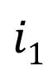

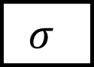
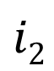
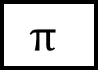

Dataflow graphs (query plans)
Boxes = computations
Arrows = values
$$Q$$
$$i1$$
$$σ$$
$$⋈$$
o
$$i2$$
$$π$$

Slide 40
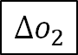
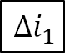
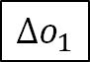
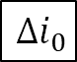
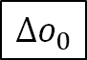
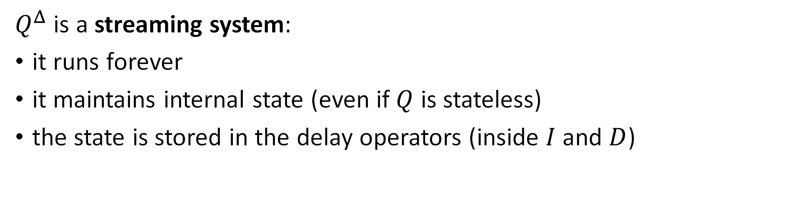
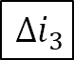
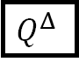
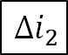
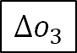
Incremental queries are streaming systems
$${Δi}_{0}$$
$${Δi}_{1}$$
$${Δi}_{2}$$
$${Δi}_{3}$$
…
$$Q^{Δ}$$
$$Δo_{0}$$
$$Δo_{1}$$
$$Δo_{2}$$
$$Δo_{3}$$
…
state
$Q^{Δ}$ is a streaming system:
it runs forever
it maintains internal state (even if $Q$ is stateless)
the state is stored in the delay operators (inside $I$ and $D$)

Slide 41
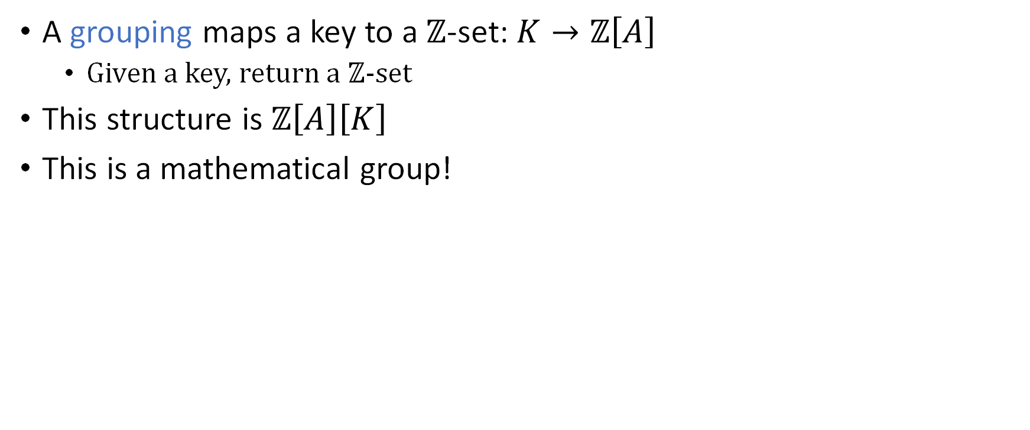
Indexed Z-sets
A grouping maps a key to a $ℤ$-set: $K→ℤ\left[A\right]$
Given a key, return a $ℤ$-set
This structure is $ℤ\left[A\right]\left[K\right]$
This is a mathematical group!
Weight
Key | Z-set
K1
K2
K3

Slide 42
Database queries work on Z-sets!
Boxes = computations
Arrows = Z-sets
$$i1$$
$$σ$$
$$⋈$$
o
$$i2$$
$$π$$

